Slide 1
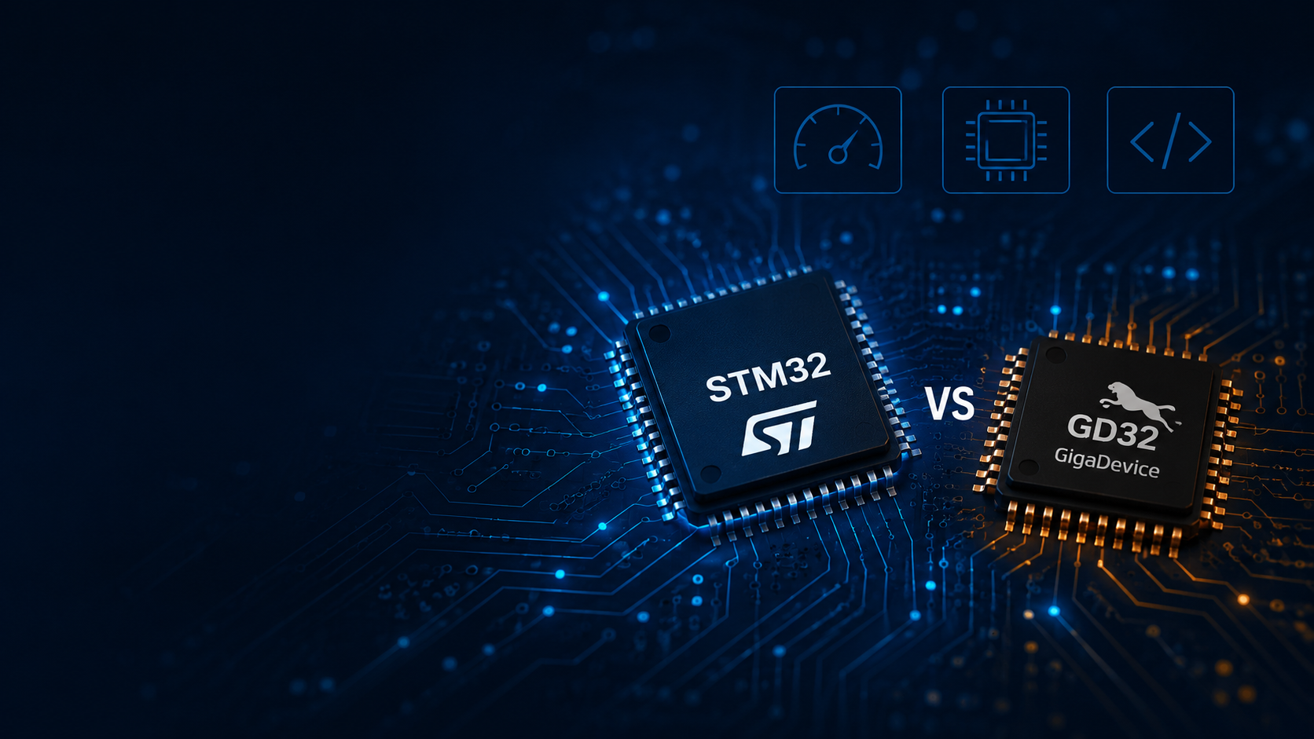

STM32 vs GD32 middleware benchmark
Comparative evaluation of middleware efficiency on Cortex-$M33$ platforms
DKHILI Fares

Slide 2










Presentation plan
FreeRTOS
Personal Contributions
Conclusion
Introduction
USB Stack
FatFs
Defined the benchmark scope, KPIs, and comparison methodology.
Benchmarked HID, CDC across footprint, timing, and transfer metrics.
Compared normalized native FreeRTOS scenarios on STM32 and GD32.
Developed custom tools for map analysis, cross-vendor comparison, and AI-assisted support.
Summarized results and continuation plan
01
02
03
04
06

Slide 3











Introduction General Benchmark Overview
Objective
❑ Develop similar scenarios on ST and peer MCU platforms using their embedded software frameworks of the scenarios across different platforms.
❑ Conduct functional testing to assess performance, memory footprint and robustness
❑ Compile a comprehensive benchmark report summarizing the results, insights, and recommendations for ST framework improvements
Plan
01
Extract
03
Teams outline short-term goals and deliverables for the defined duration.
Extract KPIs from projects (footprint, performance etc..)
Workflow Process
Stages
Deliver
02
Final output is released to marketing team for immediate feedback and use.
Build
02
Interpret
01
Create benchmark Scenarios and build them for both vendors.
Data analysis and interpretation and enhancement proposals.

Slide 4
Introduction Previously done benchmarks and marketing team review

Slide 5
Introduction Benchmarks plan and done work

Slide 6
Introduction Benchmarks plan and done work

Slide 7
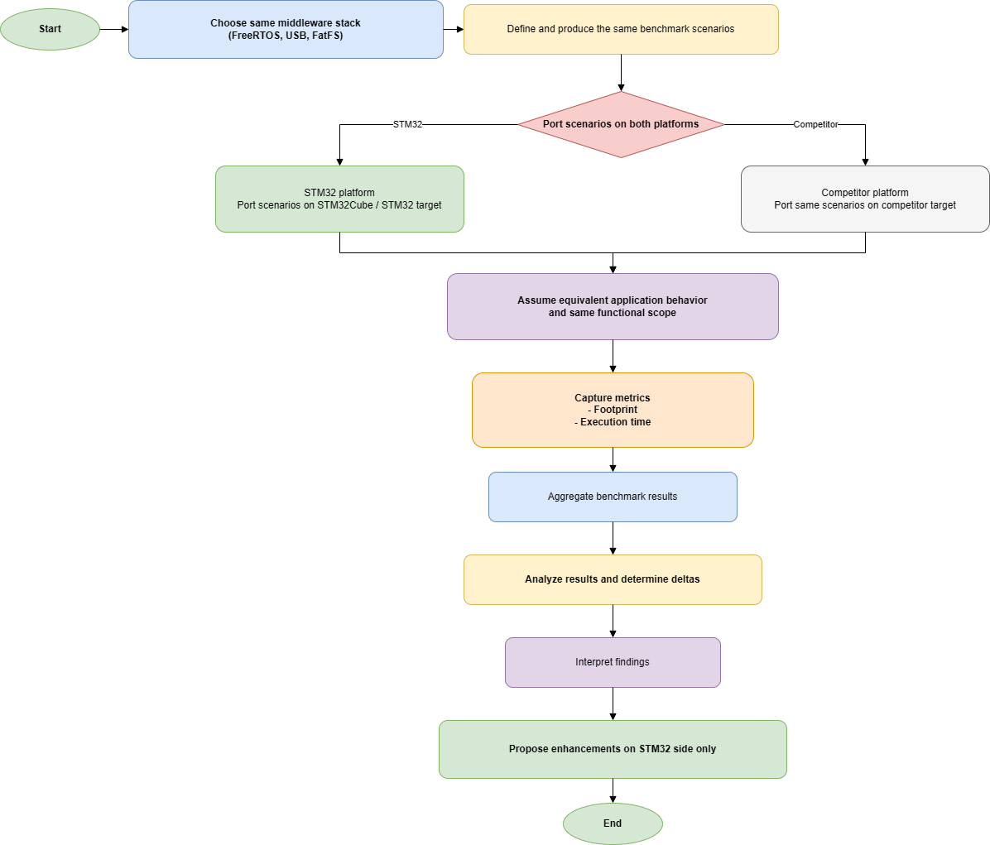
Introduction
Benchmarking middleware behavior across STMicroelectronics and Giga Device
HID
USB Stack
USB Stack
CDC
Initial Scope
MSC
Basic processing test
FreeRTOS
FreeRTOS
Cooperative test
Preemptive test
FileSystem
FileSystem
Benchmark Support Tooling
Footprint
Footprint
Initialization / Bring-up Time
Custom tools were developed to automate map-file analysis, compare cross-vendor footprint deltas, and support AI-assisted scenario porting, build, debug, and result interpretation.
Comparison Focus
Latency
Throughput

Slide 8
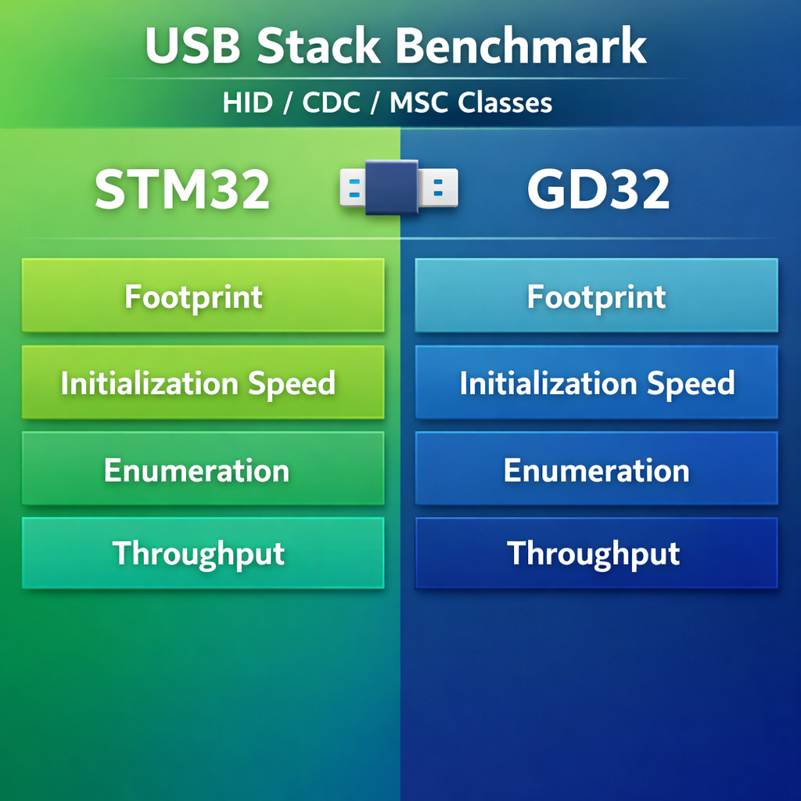
ST Competitors MW Benchmark: USB Stack ST vs GD32
USB Benchmarking Scope
This section presents the USB Device benchmarking work performed across the three selected standard classes: HID, CDC, and MSC. The objective was to compare the middleware behavior of STM32 and GigaDevice implementations under equivalent application scenarios, while focusing on the most relevant USB performance indicators.
The comparison emphasized code footprint, initialization and enumeration behavior, communication latency, and transfer performance. In addition to class-level scenarios, particular attention was given to descriptor handling, host interaction, and class-specific transfer semantics, since these factors directly affect fairness and result interpretation.
The following slides detail the benchmark methodology, the implemented scenarios, and the observations collected for each USB class.

Slide 9
ST Competitors MW Benchmark: USB ST vs GD32 Flowcharts
BareMetal mode : ST/GD USB Library CDC device class
STM32U575xx (CM33) vs GD32E507(CM33)
BareMetal mode : ST/GD USB Library USB HID device class
STM32U575xx (CM33) vs GD32E507(CM33)
Start
Start
Clock configuration
Clock source : HSI (ST) / FIRC_48M (NXP)
Clock frequency: CM33: 160 MHz (ST and GD)
Clock configuration
Clock source : HSI (ST) / FIRC_48M (NXP)
Clock frequency: CM33: 160 MHz (ST and GD)
USB configuration
U5/ GD32: USB Full Speed, USB Device, CDC class
USB Device Init
U5/ GD32: USB Full Speed, USB Device, CDC class
Is device inserted ?
No
Is device inserted ?
No
Yes
USB enemeration
USB host (PC) identify, assign address and configure USB device (MCU)
Yes
If USB Receive data
USB enemeration
USB host (PC) identify, assign address and configure USB device (MCU)
No
Yes
Send mouse report
USB transmit data
USB CDC device class: USB communication device class allows devices to communicate with computers as serial ports or network interfaces.
USB HID device class: USB Human Interface Device allows to enable communication between device (MCU) and host (PC).

Slide 10
ST Competitors MW Benchmark: USB ST vs GD32 Flowcharts
BareMetal mode : ST/NXP USB Library CDC device class
BareMetal mode : ST/NXP USB Library HID device class
Execution time (ms)
Execution time (ms)
STM32U575xx (CM33) vs GD32E507(CM33): USB FS
STM32U575xx (CM33) vs MCX-N94 XX (CM33): USB FS
 | STM32U575xx | MCX-N94X | ST vs NXP | Comment
Initialize | 9,993 | 8,159 | +22%
Enumeration | 72 | 70.4 | +2%
Transmit data | 0.00945 | 0.0095 | -1%
Receive data | 0.0094 | 0.0094 | 0%
 | STM32U575xx | MCX-N94X | ST vs NXP | Comment
Initialize | 10 | 5 | +100%
Enumeration | 319.1 | 321.1 | -1%
Data transmission | 0.0092 | 0.00921 | 0%
Footprint (Bytes)
Footprint (Bytes)
STM32U575xx (CM33) vs MCX-N94X (CM33): USB FS/ With RCC
STM32U575xx (CM33) vs MCX-N9 XX (CM33): : USB FS/ With RCC
 | STM32U575xx | MCX-N94X | ST vs NXP | Comment
ROM | 17013 | 13549 | +25.5% | * STM32 RCC Clock config 4560 bytes * FSL clock config 1470 bytes
RAM | 3065 | 1 360 | +125%
Total | 20078 | 14909 | +34%
 | STM32U575xx | MCX-N94X | ST vs NXP | Comment
ROM | 16377 | 13728 | +19.30% | * STM32 RCC Clock config 4560 bytes * FSL clock config 1558 bytes
RAM | 2422 | 1702 | +42.30%
Total | 18 799 | 15430 | +21%
STM32U575xx (CM33) vs MCX-N94X (CM33): USB FS/ Without RCC
STM32U575xx (CM33) vs MCX-N9 XX (CM33): : USB FS/ Without RCC
 | STM32U575xx | MCX-N94X | ST vs NXP | Comment
ROM | 12453 | 12087 | +3% | By removing clock configuration footprint, ST is higher by only 15% than NXP instead of 34%
RAM | 3065 | 1352 | +126%
Total | 15518 | 13439 | +15%
 | STM32U575xx | MCX-N94X | ST vs NXP | Comment
ROM | 11817 | 12282 | -3.79% | By removing clock configuration footprint, ST is higher by only 2.6% than NXP instead of 21%
RAM | 2422 | 1590 | +52%
Total | 14239 | 13872 | +2.6%

Slide 11
Section title

Slide 12
ST Competitors MW Benchmark: RTOS Flowcharts
Basic Processing Flowchart
Cooperative Processing Flowchart
Preemptive Scheduling Flowchart
Start
Start
Start
Clock configuration
Clock frequency: 160 MHz
Clock configuration
Clock frequency: 160 MHz
Clock configuration
Clock frequency: 160 MHz
Initialize a global counter to 0
Initialize 5 global counters to 0
c0 to c4
Create Counting Thread
LOW Priority
Initialize 5 global counters to 0
c0 to c4
Create 5 threads
same low priority
Create 5 threads
ascending priorities ,from lowest to highest
Create Reporting Thread
HIGH Priority
Create Reporting Thread
HIGH Priority
Start the scheduler
1 ms time slice/task
Create Reporting Thread
HIGH Priority
Start the scheduler
1 ms time slice/task
Suspend thread 1,2,3,4
Suspend Threads 1 through 4 ;start with Thread 0 active
Start Counting Thread
Start Reporting Thread
Initialize an array to 0
Initialize last_counter to 0
counter holding previous
Counter value
Start Thread i
Start Thread i+1
Start Reporting Thread
i+1 = 4
Start Thread i
Start Thread i+1
Start Reporting Thread
Update array elements
Sleep for 30 s
Task Yield
Task Yield
Sleep for 30 s
Resume thread i
Resume thread i+1
To Next thread
Increment the global counter
Print :global counter – last counter
Increment Ci
Increment Ci+1
i+1 = 4
Print the 5 counters
From Next thread
Sleep for 30 s
Increment Ci
Increment Ci+1
Print the 5 counters
Suspend Ci+1
Thread blocked for 30s and only
Thread0 runs and loop back again
To sleep for 30s

Slide 13
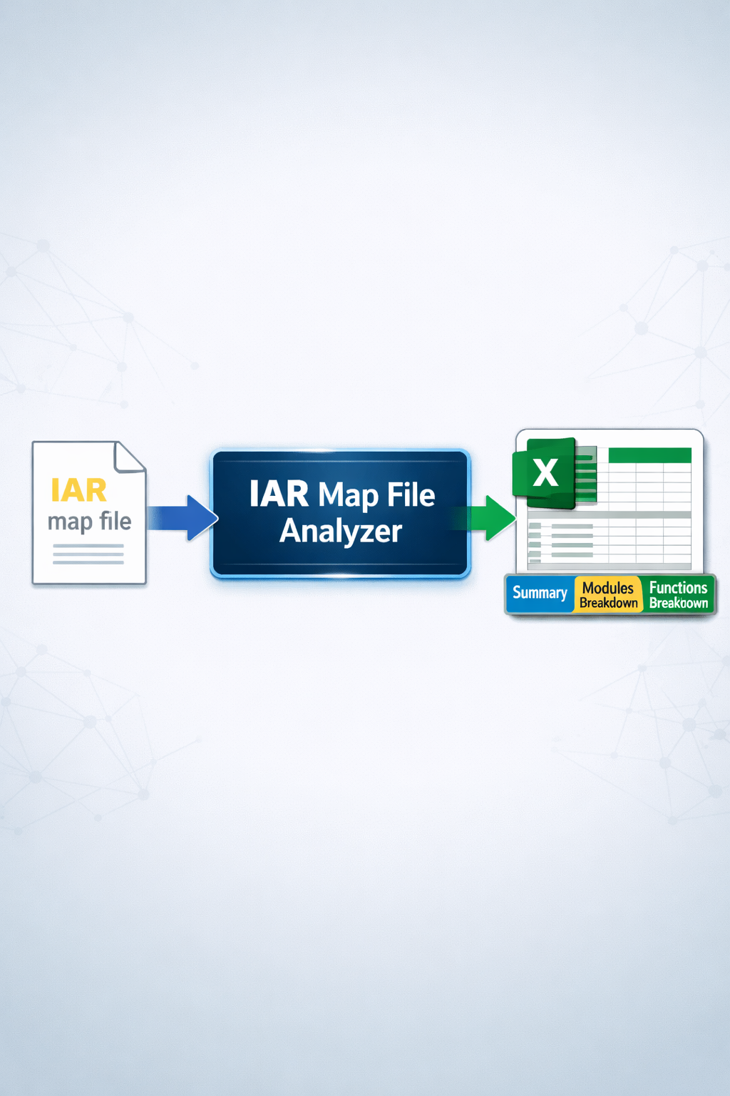
IAR EWARM Map File Analyzer
From raw linker map files to benchmark-ready memory reports

Slide 14



MCU workflow studio The problem we solve
Current challenge
Impact
IAR map files are rich in data but hard to exploit quickly
Manual analysis is slow and error-prone
Technical benchmark evidence is not always presentation-ready
Comparing STM32 vs competitors takes too much engineering effort
Delays benchmark creation
Inconsistent reporting across teams
Harder to build convincing memory-footprint narratives
Key message:
transforming complex linker output into clear, reusable benchmark evidence.

Slide 15
IAR EWARM Map File Analyzer Solution overview
MCU Workflow Studio solves this
Deterministic firmware comparisonCross-vendor analysis (STM32, NXP, TI, etc.)Converts raw map files → actionable insights
✅ Output:MappingsMetricsRecommendations

Slide 16
IAR EWARM Map File Analyzer key features
Deterministic scoring engine
Layer-based analysis
Cardinality detection
Recommendation engine
Optional AI enhancement

Slide 17
IAR EWARM Map File Analyzer System Overview
Inputs: .map / .xlsx
Processing: parsing, scoring, analysis
Outputs: reports, mappings, recommendations

Slide 18
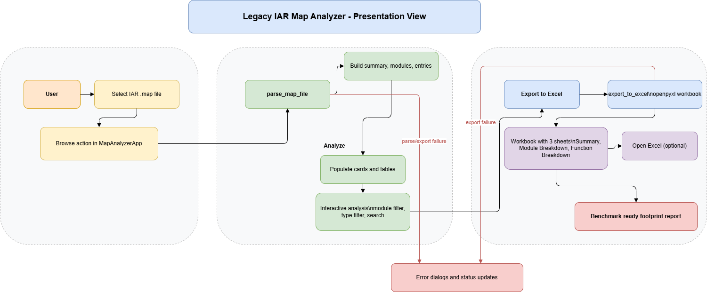
IAR EWARM Map File Analyzer End-to-end workflow
Workflow
User launches the desktop application
User selects an IAR .map file
Tool parses the file and identifies key sections
Tool computes memory KPIs
User explores results in the GUI
User exports a formatted Excel report
Teams reuse the report for benchmark communication
Technologies
Python for orchestration and parsing
Tkinter / ttk for the GUI
Regex for section extraction
openpyxl for Excel export

Slide 19
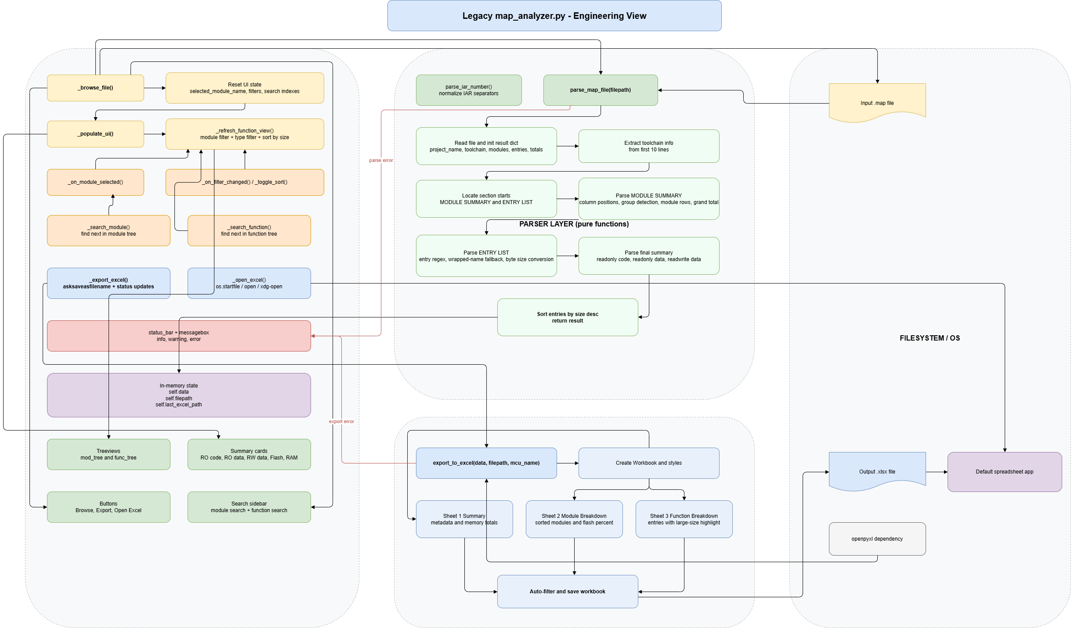
IAR EWARM Map File Analyzer Technical architecture

Slide 20
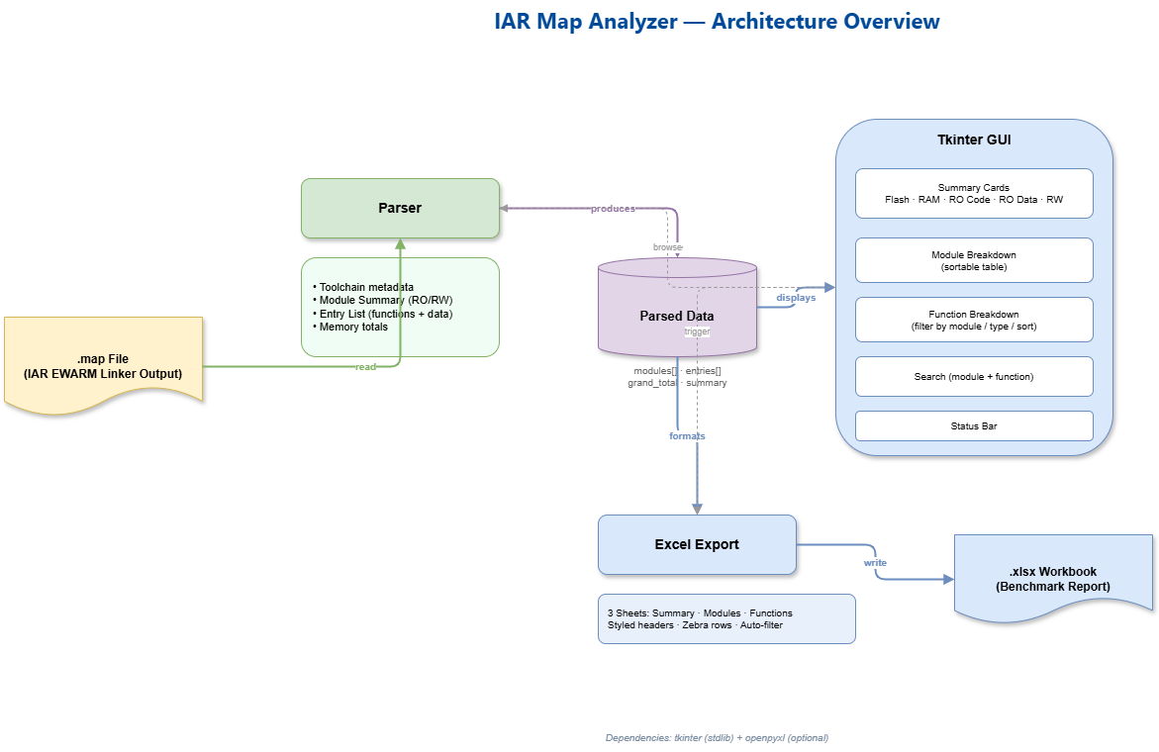
IAR EWARM Map File Analyzer Technical architecture

Slide 21

Find out more at www.st.com

Slide 22

For further support in creating a PowerPoint presentation, including graphic assets, formatting tools and additional information on the ST brand
you can visit the ST Brand Portal https://brandportal.st.com

